Slide 1

Database Technologies - MySQL
A day without new knowledge is a lost day.
Before we start DBT module.
Which module(s) you have completed?
iet
If A and a, B and b, C and c etc. are treated in the same way then it is case-insensitive. MySQL is case-insensitive
In this module we are going to learn SQL, PL/SQL and NoSQL(MongoDB)

Slide 2
Introduction
Data Access Object (DAO)
If anyone who wants to develop a good application
then he should have the knowledge three major components.
They are . . . . .
(3-Tier Architecture).
Presentation Tier [ UI ]
Application Tier [ Server Application and Client Application ]
Data Layer / Data Access Layer [ Flat Files / RDBMS / NoSQL ]
So as a programmer:
a person should understand and be able to interact with a database is must, so than the data which is collected from the UI is processed and stored permanently. (eg. Any management systems, set top box, washing machine, mobile application etc.).
The term “front-end” refers to the user interface, while “back-end” means the server, application and database that work behind the scenes to deliver information to the user.

Slide 3
Introduction
Why do we need databases (Use Case)?
We need databases because they organize data in a manner which allows us to store, query, sort, and manipulate data in various ways. Databases allow us to do all this things.
Many companies collects data from different resource (like Weather data, Geographical data, Finance data, Scientific data, Transport data, Cultural data, etc.)

Slide 4
What is Relation and Relationship?

Slide 5
relation and relationship?
Relation (in Relational Algebra "R" stands for relation): In Database, a relation represents a table or an entity than contain attributes.
Relationship: In database, relationship is that how the two entities are connected to each other, i.e. what kind of relationship type they hold between them.
Primary/Foreign key is used to specify this relationship.
Remember:
Foreign Key is also know as
Reference
Referential key.
Note:
Table - The physical instantiation of a relation in the database schema.
Relation - A logical construct that organizes data into rows and columns.

Slide 6
File Systems is the traditional way to keep your data organized.
File System
vs
DBMS

Slide 7
file-oriented system
struct Employee {
int emp_no;
char emp_name[50];
int salary;
} emp[1000];
struct Employee {
int emp_no;
char emp_name[50];
int salary;
};
struct Employee emp[1000];
File Anomalies
c:\employee.txt
c:\employee.txt
c:\employee.txt
c:\employee.txt
c:\employee.txt
1 suraj 4000
2 ramesh 6000
3 rajan 4500
. |
. |
. |
500 sam 3500
. |
. |
. |
1000 amit 2300
1 suraj 4000
2 ramesh 6000
3 rajan 4500
. |
. |
. |
500 sam 3500
. |
. |
1000 amit 2300
. |
. |
. |
2000 jerry 4500
. |
. |
1 suraj 4000
2 ramesh 6000
3 rajan 4500
. |
. |
. |
500 pankaj 3500
. |
. |
1000 amit 2300
. |
1000 amit 2300
. |
2000 jerry 4500
. |
. |
1 suraj 4000
2 ramesh 6000
3 rajan 4500
. |
. |
. |
pankaj 500 3500
. |
. |
1000 amit 2300
. |
1000 amit 2300
. |
jerry 2000 4500
. |
. |
1 suraj 4000
2 ramesh 6000
3 rajan 4500
. |
. |
. |
500 sam 3500
. |
. |
. |
. |
. |
1250 neel 4500

Slide 8
Create/Open an existing file
Reading from file
Writing to a file
Closing a file
file-oriented system
File Anomalies
c:\employee.txt
file attributes
file permissions
search empl ID=1
search emp_name
1 suraj 4000
2 ramesh 6000
3 rajan 4500
. |
. |
. |
500 sam 3500
. |
. |
. |
1000 amit 2300
File Name
Type
Location
File permissions
Share permissions
1 suraj 4000
2 ramesh 6000
3 rajan 4500
. |
. |
. |
500 sam 3500
. |
. |
. |
1000 amit 2300
1 suraj 4000
2 ramesh 6000
3 rajan 4500
. |
. |
. |
500 sam 3500
. |
. |
. |
1000 amit 2300

Slide 9
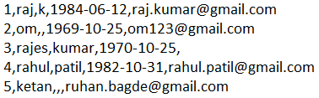
file-oriented system
A flat file database is a database that stores data in a plain text file (e.g. *.txt, *.csv, *.tsv etc. format). Each line of the text file holds one record, with fields separated by delimiters, such as commas or tabs.
1 rajan MG Road Pune MH 34500
2 rahul patil SSG Lane Pune MH 54000
3 suraj raj k Deccan Gymkhana Pune MH 22000
4, S M Kumar, Mg Road Pune MH, 32000
5, S M Kumar, Mg Road, Pune, MH, 32000
The Zen of Python,
Beautiful is better than ugly.
Explicit is better than implicit.
Simple is better than complex.
Complex is better than complicated.
Flat is better than nested.
Sparse is better than dense.
Readability counts.
Special cases aren't special enough to break the rules.
Although practicality beats purity.
Errors should never pass silently.
Unless explicitly silenced.
In the face of ambiguity, refuse the temptation to guess.
There should be one-- and preferably only one --obvious way to do it.
Although that way may not be obvious at first unless you're Dutch.
Now is better than never.
Although never is often better than *right* now.
If the implementation is hard to explain, it's a bad idea.
If the implementation is easy to explain, it may be a good idea.
Namespaces are one honking great idea -- let's do more of those!

Slide 10
advantages of file-oriented system
The biggest advantage of file-based storage is that anyone can understand the system.
Advantage of File-oriented system
Backup: It is possible to take faster and automatic back-up of database stored in files of computer-based systems.
Data retrieval: It is possible to retrieve data stored in files in easy and efficient way.
Editing: It is easy to edit any information stored in computers in form of files.
Remote access: In computer-based systems, it is possible to access data remotely.
Sharing: Data stored in files of computer-based systems can be shared among multiple users at a same time.

Slide 11
disadvantage of file-oriented system
The biggest disadvantage of file-based storage is as follows.
Disadvantage of File-oriented system
Data redundancy: It is possible that the same information may be duplicated in different files. This leads to data redundancy results in memory wastage. (Suppose a customer having both kind of accounts- saving and current account. In such a situation a customers detail are stored in both the file, saving.txt- file and current.txt- file , which leads to Data Redundancy.)
Data inconsistency: Because of data redundancy, it is possible that data may not be in consistent state. (Suppose customer changed his/her address. There might be a possibility that address is changed in only one file (saving.txt) and other (current.txt) remain unchanged.)
Limited data sharing: Data are scattered in various files and also different files may have different formats (for example: .txt, .csv, .tsv and .xml) and these files may be stored in different folders so, due to this it is difficult to share data among different applications.
Data Isolation: Because data are scattered in various files, and files may be in different formats (for example: .txt, .csv, .tsv and .xml), writing new application programs to retrieve the appropriate data is difficult.
Data security: Data should be secured from unauthorized access, for example a account holder in a bank should not be able to see the account details of another account holder, such kind of security constraints are difficult to apply in file processing systems.

Slide 12

Relation Schema: A relation schema represents name of the relation with its attributes.
e.g. student (roll_no, name, address, phone and age) is relation schema for STUDENT
DBMS
The database management system (DBMS) is the software that interacts with end users, applications, and the database itself to store and analyze the data.
database: Is the collection of related data which is organized, database can store and retrieve large amount of data easily, which is stored in one or more data files by one or more users, it is called as structured data.
management system: is a software, designed to define, manipulate, retrieve and manage data in a database.
A database is an organized collection of structured information.

Slide 13
Difference between File System and DBMS
File Management System | Database Management System
File System is easy-to-use system to store data which require less security and constraints. | Database Management System is used when security constraints are high.
Data Redundancy is more in File System. | Data Redundancy is less in Database Management System.
Data Inconsistency is more in File System. | Data Inconsistency is less in Database Management System.
Centralization is hard to get when it comes to File System. | Centralization is achieved in Database Management System.
User locates the physical address of the files to access data in File System. | In Database Management System, user is unaware of physical address where data is stored.
Security is low in File System. | Security is high in Database Management System.
File System stores unstructured data. "unstructured data" may include documents, audio, video, images, and files. | Database Management System stores structured data.

Slide 14



relational database management system?
A RDBMS is a database management system (DBMS) that is based on the relational model introduced by Edgar Frank Codd at IBM in 1970.
RDBMS supports
client/server Technology
Highly Secured
Relationship (PK/FK)
A server is a computer program or device that provides a service to another computer program and its user, known as the client.
In the client/server programming model, a server program awaits and fulfills requests from client programs, which might be running in the same, or other computers.

Slide 15
relational model concepts
and
properties of relational table

Slide 16
relational model concepts
Relational model organizes data into one or more tables (or "relations") of columns and rows. Rows are also called records or tuples. Columns are also called attributes.
Tables − In relational model, relations are saved in the form of Tables. A table has rows and columns.
Attribute − Attributes are the properties that define a relation. e.g. (roll_no, name, address, phone and age)
Tuple − A single row of a table, which contains a single record for that relation is called a tuple.
Relation schema − A relation schema describes the relation name (table name) with its attribute (columns) names.
Attribute domain − Every attribute has some pre-defined datatypes, known as attribute domain.
Relation key − Each row has one or more attributes, known as relation key, which can identify the row in the relation (table) uniquely.
e.g. student(roll_no, name, address, phone and age) is relation schema for student relation.

Slide 17
properties of relational table
ID | job | firstName | DoB | salary
1 | manager | Saleel Bagde | yyyy-mm-dd | ●●●●●●
3 | salesman | Sharmin | yyyy-mm-dd | ●●●●●●
4 | accountant | Vrushali | yyyy-mm-dd | ●●●●●●
2 | salesman | Ruhan | yyyy-mm-dd | ●●●●●●
5 | 9500 | manager | yyyy-mm-dd | ●●●●●●
5 | Salesman | Rahul Patil | yyyy-mm-dd | ●●●●●●
Domain refers to all the valid values which a column may contain.
Relational tables have six properties:
Values are atomic.
Column values are of the same kind. (Attribute Domain: Every attribute has some pre-defined datatypes, known as attribute domain.)
Each row is unique.
The sequence of columns is insignificant – (unimportant).
The sequence of rows is insignificant – (unimportant).
Each attribute/column must have a unique name.

Slide 18

What is data?

Slide 19

what is data?
Data is any facts that can be stored and that can be processed by a computer.
Data can be in the form of Text or Multimedia
e.g.
number, characters, or symbol
images, audio, video, or signal

Slide 20
What is Entity Relationship Diagram?

Slide 21
Entity Relationship Diagram (ER Diagram)
Use E-R model to get a high-level graphical view to describe the "ENTITIES" and their "RELATIONSHIP"
The basic constructs/components of ER Model are
Entity, Attributes and Relationships.

Slide 22
An entity can be a real-world object.
What is Entity?

Slide 23
entity
In relation to a database , an entity is a
Person(student, teacher, employee, department, …)
Place(classroom, building, …) --a particular position or area
Thing(computer, lab equipment, …) --an object that is not named
Concept(course, batch, student’s attendance, …) -- an idea,
about which data can be stored. All these entities have some attributes or properties that give them their identity.
Every entity has its own characteristics.

Slide 24

When you are designing attributes for your entities, you will sometimes find that an attribute does not have a value. For example, you might want an attribute for a person's middle name, but you can't require a value because some people have no middle name. For these, you can define the attribute so that it can contain null values.
What is an Attribute?
Attributes are the properties that define a relation.
e.g. student(ID, firstName, middleName, lastName, city)
Entity
In some cases, you might not want a specific attribute to contain a null value, but you don't want to require that the user or program always provide a value. In this case, a default value might be appropriate. A default value is a value that applies to an attribute if no other valid value is available.
Attribute

Slide 25
attributes
A table has rows and columns
In RDBMS, a table organizes data in rows and columns. The COLUMNS are known as ATTRIBUTES / FIELDS whereas the ROWS are known as RECORDS / TUPLE.
In Relation: EMP
Attributes
ID | EmployeeName | Job | Hiredate | Salary
1 | KING | PRESIDENT | 2017-02-15 | 5000
… | … | … | … | …
… | … | … | … | …
… | … | … | … | …
Rows

Slide 26
attributes
In Entity Relationship(ER) Model attributes can be classified into the following types.
Simple/Atomic and Composite Attribute
Single Valued and Multi Valued attribute
Stored and Derived Attributes
Complex Attribute

Slide 27
attributes
Simple / Atomic Attribute --VS-- Composite Attribute
(Can’t be divided further) (Can be divided further)
Single Value Attribute --VS-- Multi Valued Attribute
(Only One value) (Multiple values)
Stored Attribute --VS-- Derived Attribute
(Only One value) (Virtual)
Complex Attribute
(Composite & Multivalued)
Atomic Attribute: An attribute that cannot be divided into smaller independent attribute is known as atomic attribute.
e.g. ID’s, age, gender, zip, marital status cannot further divide.
Single Value Attribute: An attribute that has only single value is known as single valued attribute.
e.g. manufactured part can have only one serial number, voter card, blood group, price, quantity, branch can have only one value.
Stored Attribute: The stored attribute are such attributes which are already stored in the database and from which the value of another attribute is derived.
e.g. (HRA, DA…) can be derive from salary, age can be derived from DoB, total marks or average marks of a student can be derived from marks.

Slide 28
Composite VS Multi Valued Attribute

Slide 29

composite / multi valued attributes
Composite Attribute
Person Entity
Name attribute: ( firstName, middleName, and lastName )
PhoneNumber attribute: ( countryCode, cityCode, and phoneNumber )
Multi Valued Attribute
Person Entity
Hobbies attribute: [ reading, hiking, hockey, skiing, photography, . . . ]
SpokenLanguages attribute: [ Hindi, Marathi, Gujarati, English, . . . ]
Degrees attribute: [ 10th , 12th, BE, ME, PhD, . . . ]
emailID attribute: [ saleel@gmail.com, salil@yahoomail.com, . . . ]

Slide 30
What is an Prime, Non-Prime Attribute?

Slide 31
attributes
Prime attribute (Entity integrity)
An attribute, which is a part of the prime-key (candidate key), is known as a prime attribute.
Non-prime attribute
An attribute, which is not a part of the prime-key (candidate key), is said to be a non-prime attribute.

Slide 32
Entity Relationship Diagram Symbols

Slide 33
erdplus.com
www.draw.io
entity relationship diagram symbols
Attribute
Composite Attribute
Key Attribute
Strong Entity
Weak Entity
Derived Attribute
Weak Relationship
Relationship
Multivalued Attribute

Slide 34
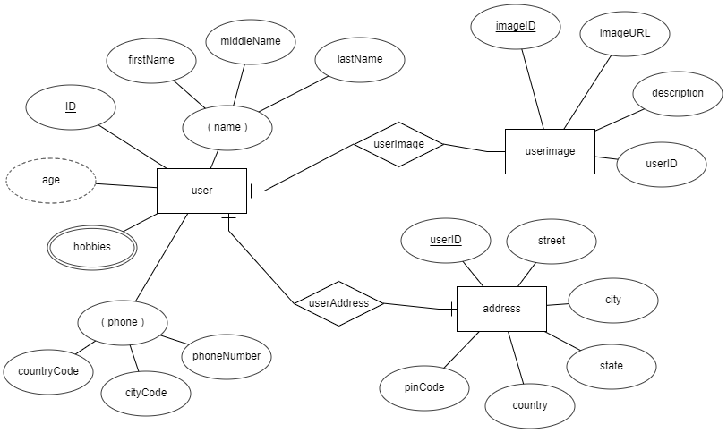
entity relationship diagram
DoB

Slide 35
What is a degree, cardinality, domain and union in database?
Degree d(R) / Arity: Total number of attributes/columns present in a relation/table is called degree of the relation and is denoted by d(R).
Cardinality |R|: Total number of tuples/rows present in a relation/table, is called cardinality of a relation and is denoted by |R|.
Domain: Total range of accepted values for an attribute of the relation is called the domain of the attribute. (Data Type)
Union Compatibility: Two relations R and S are set to be Union Compatible to each other if and only if:
They have the same degree d(R).
Domains of the respective attributes should also be same.

Slide 36
Data integrity refers to the correctness and completeness of data.
A domain constraint and types of data integrity constraints
Domain Constraint = data type + Constraints (not null/unique/primary key/foreign key/check/default)
e.g. custID INT, constraint pk_custid PRIMARY KEY(custID)
Three types of integrity constraints: entity integrity, referential integrity and domain integrity:
Entity integrity: Entity Integrity Constraint is used to ensure the uniqueness of each record the table. There are primarily two types of integrity constraints that help us in ensuring the uniqueness of each row, namely, UNIQUE constraint and PRIMARY KEY constraint.
Referential integrity: Referential Integrity Constraint ensures that there always exists a valid relationship between two tables. This makes sure that if a foreign key exists in a table relationship then it should always reference a corresponding value in the second table or it should be null.
Domain integrity: A domain is a set of values of the same type. For example, we can specify if a particular column can hold null values or not, if the values have to be unique or not, the data type or size of values that can be entered in the column, the default values for the column, etc..

Slide 37
Keys are used to establish relationships between tables and also to uniquely identify any record in the table.
types of Keys?
r = Employee(EmployeeID, FullName, job, salary, PAN, DateOfBirth, emailID, deptno)
Candidate Key: are individual columns in a table that qualifies for uniqueness of all the rows. Here in Employee table EmployeeID, PAN or emailID are Candidate keys.
Primary Key: is the columns you choose to maintain uniqueness in a table. Here in Employee table you can choose either EmployeeID, PAN or emailID columns, EmployeeID is preferable choice.
Alternate Key: Candidate column other the primary key column, like if EmployeeID is primary key then , PAN or emailID columns would be the Alternate key.
Super Key: If you add any other column to a primary key then it become a super key, like EmployeeID + FullName is a Super Key.
Composite Key: If a table do not have any single column that qualifies for a Candidate key, then you have to select 2 or more columns to make a row unique. Like if there is no EmployeeID, PAN or emailID columns, then you can make FullName + DateOfBirth as Composite key. But still there can be a narrow chance of duplicate row.

Slide 38
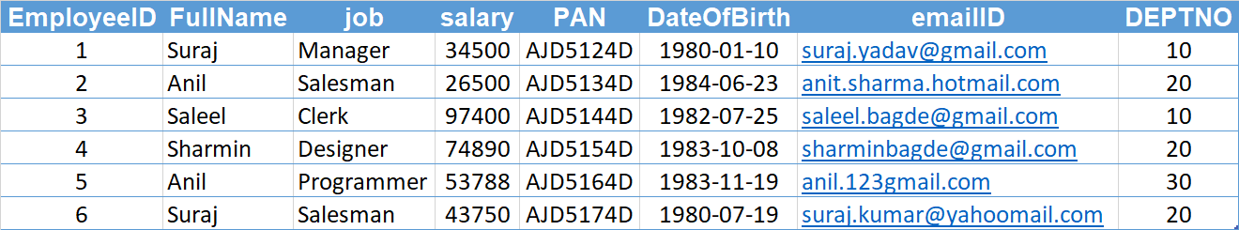
Candidate Key
Primary Key
Composite Key
Alternate Key

Slide 39
Degrees of relationship
The degree of relationship can be defined as the number of occurrences in one entity that is associated with the number of occurrences in another entity.

Slide 40

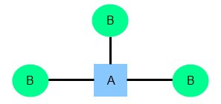
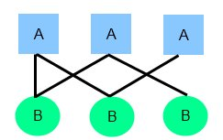
relationships
There are three degrees of relationship
one-to-one (1:1)
one-to-many (1:M)
many-to-many (M:N)

Slide 41
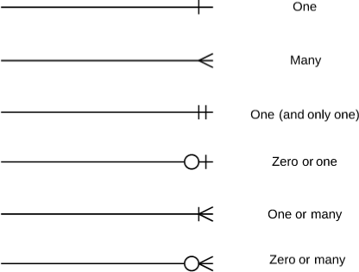
relationships

Slide 42
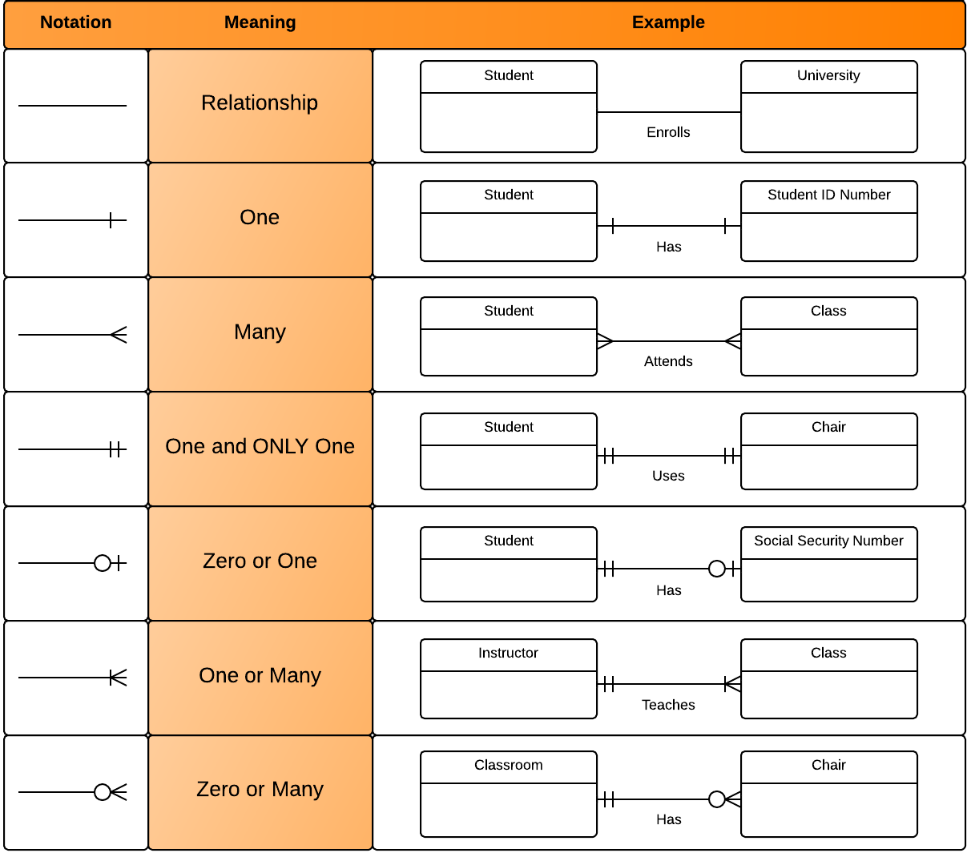
relationships

Slide 43
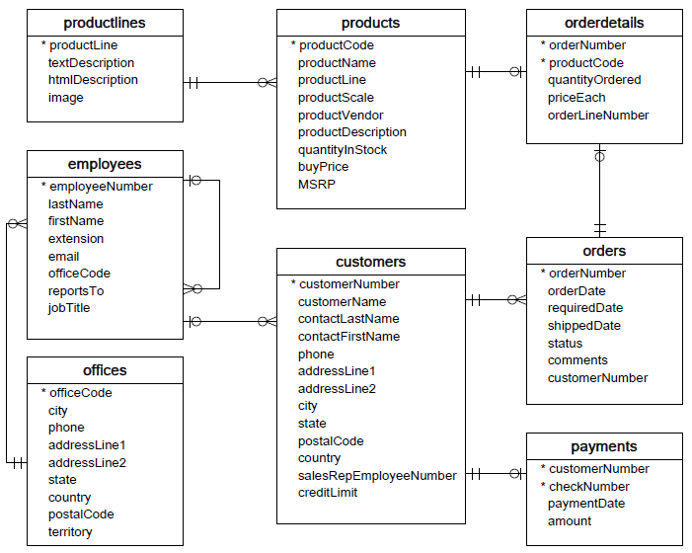

Slide 44
one-to-one relationship

Slide 45
one-to-one relationship
A one-to-one relationship between two tables means that a row in one table can only relate to zero/one row in the table on the other side of their relationship. This is the least common database relationship.
A one-to-one relationship is a type of cardinality that refers to the relationship between two entities R and S in which one element of entity R may only be linked to zero/one element of entity S, and vice versa.
Country
Capital
Country
Capital
Country
one-to-one relationship
Capital
Country
Capital
=
Country
Capital
Country
Capital

Slide 46
one-to-one relationship
A one-to-one relationship between two tables means that a row in one table can only relate to zero/one row in the table on the other side of their relationship. This is the least common database relationship.
A one-to-one relationship is a type of cardinality that refers to the relationship between two entities R and S in which one element of entity R may only be linked to zero/one element of entity S, and vice versa.
Person-1
Passport-1
Person-1
Passport-1
Person-2
Passport-1
Person-2
Passport-1
one-to-one relationship
=
Person-3
Passport-1
Person-4
Passport-1
Person-4

Slide 47
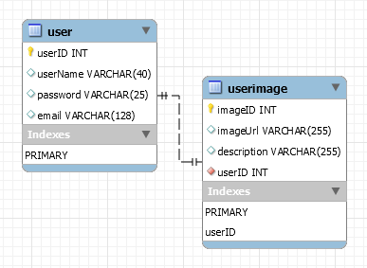
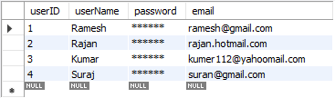
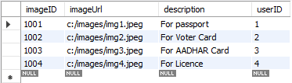
how to create one-to-one relationship
CREATE TABLE user (
userID INT PRIMARY KEY,
userName VARCHAR(40),
password VARCHAR(25),
email VARCHAR(128)
) ;
CREATE TABLE userImage (
imageID INT PRIMARY KEY,
imageUrl VARCHAR(255),
description VARCHAR(255),
userID INT NOT NULL UNIQUE,
FOREIGN KEY(UserID) REFERENCES user(userID)
) ;

Slide 48
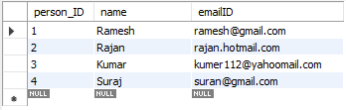

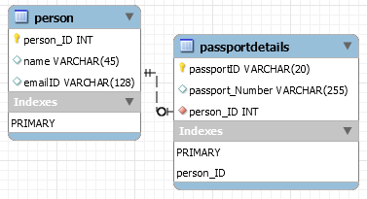
how to create one-to-one relationship
CREATE TABLE person (
person_ID INT PRIMARY KEY ,
name VARCHAR(45),
emailID VARCHAR(128)
);
CREATE TABLE passportDetails (
passportID VARCHAR(20) PRIMARY KEY,
passport_Number VARCHAR(255),
person_ID INT UNIQUE,
FOREIGN KEY(person_ID) REFERENCES person(person_ID)
);

Slide 49
one-to-many relationship

Slide 50
one-to-many relationship
A one-to-many relationship between two tables means that a row in one table can have zero or more row in the table on the other side of their relationship.
a one-to-many relationship is a type of cardinality that refers to the relationship between two entities R and S in which an element of R may be linked to many elements of S, but a member of S is linked to only one element of R.
Customer-1
Order-1
Customer-1
Order-1
Customer-2
Order-1
Customer-2
Order-1
one-to-many relationship
Customer-3
Order-2
=
Customer-2
Order-2
Customer-4
Order-1
Customer-3
Order-1
Customer-5
Order-2
Customer-3
Order-2
Order-3
Customer-3
Order-3
Order-1
Customer-4
Order-1

Slide 51
one-to-many relationship
A one-to-many relationship between two tables means that a row in one table can have one or more row in the table on the other side of their relationship.
a one-to-many relationship is a type of cardinality that refers to the relationship between two entities R and S in which an element of R may be linked to many elements of S, but a member of S is linked to only one element of R.
Invoice-1
Invoice_Item-1
Invoice-1
Invoice_Item-1
Invoice-2
Invoice_Item-1
Invoice-2
Invoice_Item-1
one-to-many relationship
Invoice-3
Invoice_Item-2
=
Invoice-2
Invoice_Item-2
Invoice-4
Invoice_Item-1
Invoice-3
Invoice_Item-1
Invoice_Item-2
Invoice-3
Invoice_Item-2
Invoice_Item-2
Invoice-3
Invoice_Item-3
Invoice_Item-1
Invoice-4
Invoice_Item-1

Slide 52
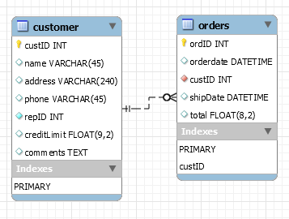
how to create one-to-many relationship
CREATE TABLE customer (
custID INT PRIMARY KEY,
name VARCHAR(45),
address VARCHAR(240),
phone VARCHAR(45),
repID INT NOT NULL,
creditLimit FLOAT(9,2),
comments TEXT,
constraint custid_zero CHECK(custID > 0)
);
CREATE TABLE orders (
ordID INT PRIMARY KEY,
orderdate DATETIME,
custID INT NOT NULL,
shipDate DATETIME,
total FLOAT(8,2),
FOREIGN KEY(custID) REFERENCES customer(custID),
constraint total_greater_zero CHECK(total >= 0)
);

Slide 53
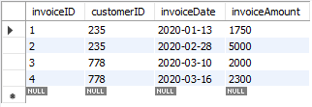
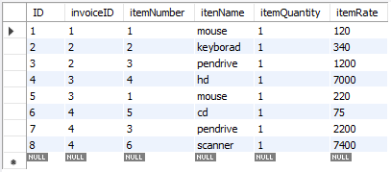
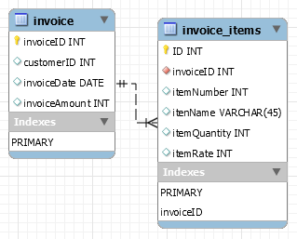
how to create one-to-many relationship
CREATE TABLE invoice (
invoiceID INT PRIMARY KEY,
customerID INT,
invoiceDate DATE,
invoiceAmount INT
);
CREATE TABLE invoice_items (
ID INT PRIMARY KEY,
invoiceID INT NOT NULL,
itemNumber INT,
itenName VARCHAR(45),
itemQuantity INT,
itemRate INT,
FOREIGN KEY(invoiceID) REFERENCES invoice(invoiceID)
);

Slide 54
many-to-one relationship

Slide 55
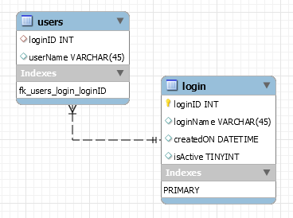
many-to-one relationship
CREATE TABLE users (
loginID INT,
userName VARCHAR(45),
constraint fk_users_login_loginID FOREIGN KEY(loginID) REFERENCES login(loginID)
);
CREATE TABLE login (
loginID INT,
loginName VARCHAR(45),
createdON DATETIME,
isActive TINYINT,
PRIMARY KEY(loginID)
);

Slide 56
many-to-many relationship

Slide 57
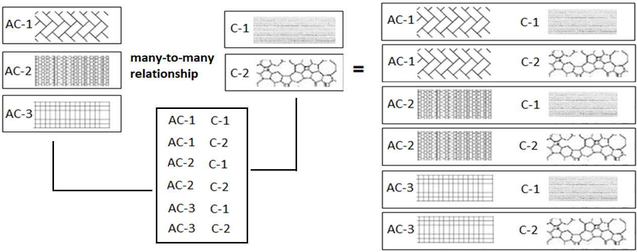
many-to-many relationship
A many-to-many relationship is a type of cardinality that refers to the relationship between two entities R and S in which R may contain a parent instance for which there are many children in S and vice versa.
=
=

Slide 58
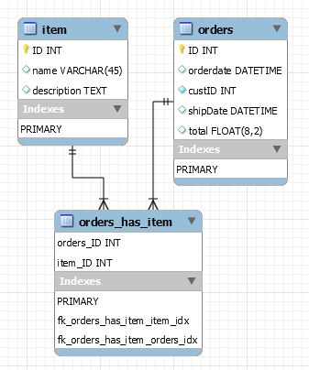
how to create many-to-many relationship
CREATE TABLE item (
item_ID INT PRIMARY KEY,
name VARCHAR(45),
description TEXT
);
CREATE TABLE orders (
orders_ID INT PRIMARY KEY,
orderdate DATETIME,
custID INT NOT NULL,
shipDate DATETIME,
total FLOAT(8,2),
constraint total_greater_zero CHECK(total >= 0)
);
CREATE TABLE orders_has_item (
orders_ID INT NOT NULL,
item_ID INT NOT NULL,
PRIMARY KEY(orders_ID, item_ID),
constraint fk_orders_has_item_orders FOREIGN KEY(orders_ID)
REFERENCES orders(ID),
constraint fk_orders_has_item_item1 FOREIGN KEY(item_ID)
REFERENCES item(ID)
);

Slide 59
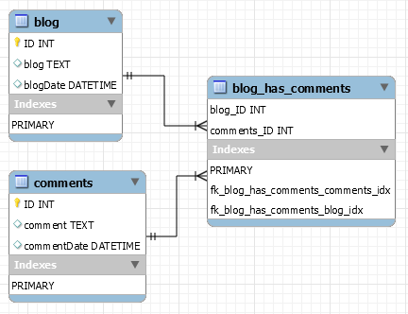
how to create many-to-many relationship
CREATE TABLE blog (
ID INT PRIMARY KEY,
blog TEXT,
blogDate DATETIME
);
CREATE TABLE comments (
ID INT PRIMARY KEY,
comment TEXT,
commentDate DATETIME
);
CREATE TABLE blog_has_comments (
blog_ID INT,
comments_ID INT,
PRIMARY KEY(blog_ID, comments_ID),
constraint fk_blog_has_comments_blog FOREIGN KEY(blog_ID) REFERENCES blog(ID),
constraint fk_blog_has_comments_comments FOREIGN KEY(comments_ID) REFERENCES comments(ID)
);

Slide 60

MySQL
MySQL is the most popular Open Source
Relational Database Management System.
MySQL was created by a Swedish company - MySQL AB that was founded in 1995. It was acquired by Sun Microsystems in 2008; Sun was in turn acquired by Oracle Corporation in 2010.
When you use MySQL, you’re actually using at least two programmes. One program is the MySQL server (mysqld.exe) and other program is MySQL client program (mysql.exe) that connects to the database server.

Slide 61
What is SQL?

Slide 62

what is sql?
SQL (Structured Query Language) is a database language designed and developed for managing data in relational database management systems (RDBMS). SQL is common language for all Relational Databases.

Slide 63
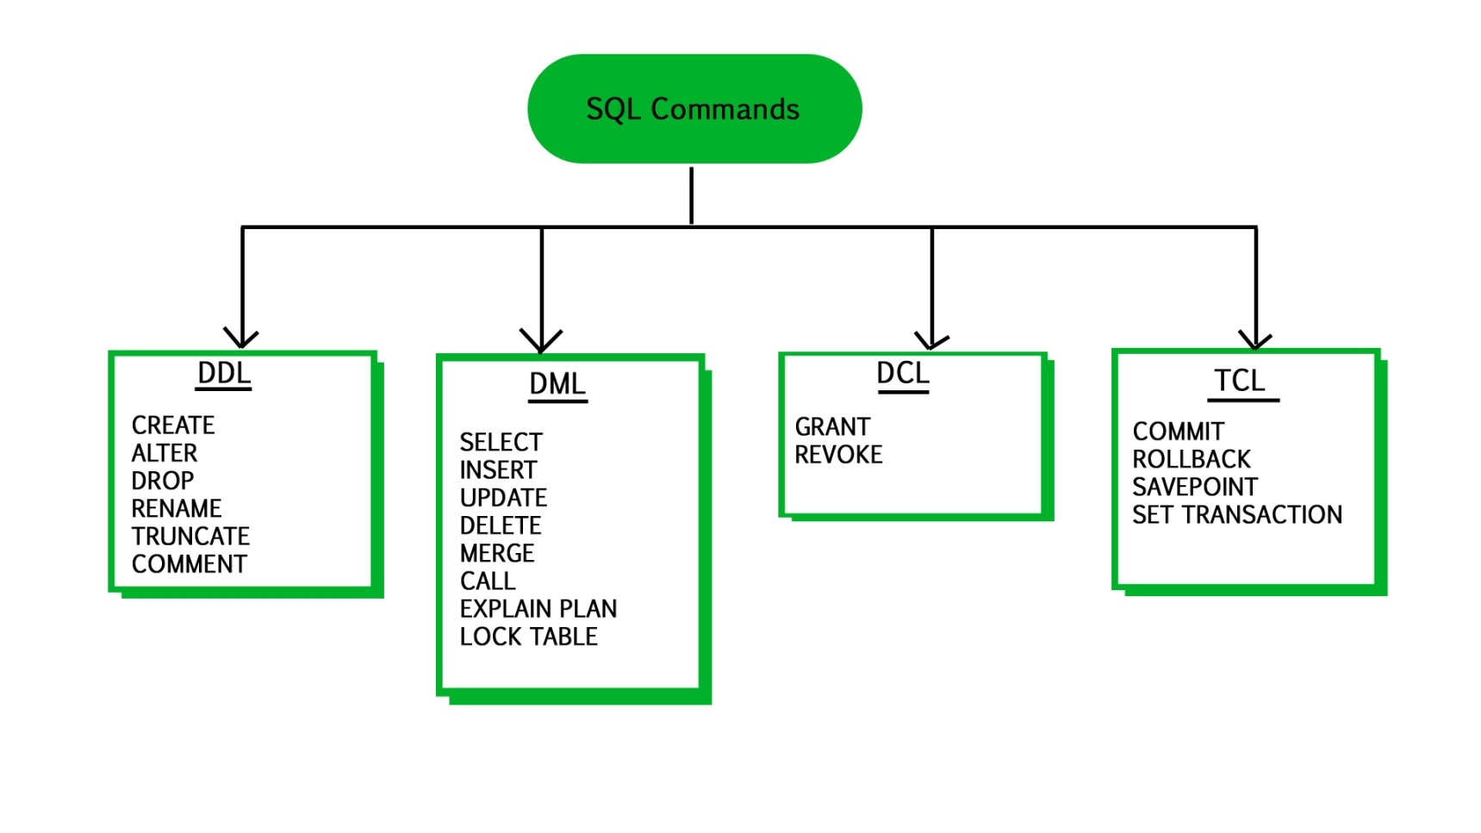
what is sql?
Note:
Explicit or implicit commit will commit the data.
Remember:
A NULL value is not treated as a blank or 0. Null or NULL is a special marker used in Structured Query Language to indicate that a data value does not exist in the database.
Degree d(R): Total no. of attributes/columns present in a relation/table is called degree of the relation and is denoted by d(R).
Cardinality |R|: Total no. of tuples present in a relation or Rows present in a table, is called cardinality of a relation and is denoted by |R|.

Slide 64
comments in mysql
From a # character to the end of the line.
From a -- sequence to the end of the line.
From a /* sequence to the following */ sequence.
Reconnect to the server | \r
Execute a system shell command | \!
Exit mysql | \q

Slide 65
Login to MySQL

Slide 66
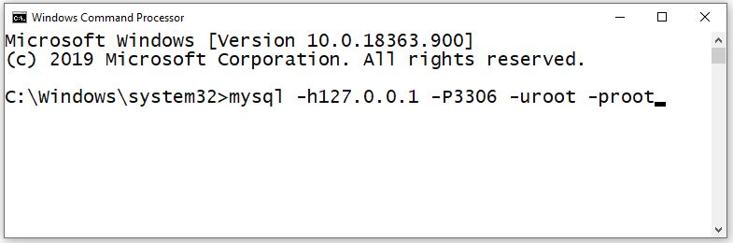
login
Default port for MySQL Server: 3306
C:\> mysql -hlocalhost -P3307 -uroot -p
C:\> mysql -h127.0.0.1 -P3307 -uroot -p [database_name]
C:\> mysql -h192.168.100.14 -P3307 -uroot -psaleel [database_name]
C:\> mysql --host localhost --port 3306 --user root --password=ROOT [database_name]
C:\> mysql --host=localhost --port=3306 --user=root --password=ROOT [database_name]

Slide 67
SHOW DATABASES

Slide 68
SHOW DATABASES Syntax
SHOW {DATABASES | SCHEMAS} [LIKE 'pattern' | WHERE expr]
SHOW SCHEMAS is a synonym for SHOW DATABASES.
SHOW DATABASES;
SHOW SCHEMAS;
SHOW DATABASES LIKE 'U%';
SHOW SCHEMAS LIKE 'U%';
NULL means “no database is selected”. Issue the USE dbName command to select the database.

Slide 69
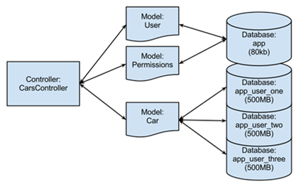
USE DATABASES
The USE db_name statement tells MySQL to use the db_name database as the default (current) database for subsequent statements. The database remains the default until the end of the session or another USE statement is issued.

Slide 70
USE DATABASES Syntax
USE db_name
\U db_name
Note:
USE, does not require a semicolon.
USE must be followed by a database name.
USE db1
\U db1

Slide 71
CREATE DATABASE

Slide 72
create database
CREATE DATABASE creates a database with the given name. To use this statement, you need the CREATE privilege for the database.
CREATE {DATABASE | SCHEMA} [IF NOT EXISTS] db_name
CREATE SCHEMA is a synonym for CREATE DATABASE.
CREATE DATABASE db1;
CREATE DATABASE IF NOT EXISTS db1;

Slide 73
DROP DATABASE
If the default database is dropped, the default database is unset (the DATABASE() function returns NULL).

Slide 74
drop database
DROP DATABASE drops all tables in the database and deletes the database. Be very careful with this statement! To use DROP DATABASE, you need the DROP privilege on the database.
DROP {DATABASE | SCHEMA} [IF EXISTS] db_name
DROP SCHEMA is a synonym for DROP DATABASE.
DROP DATABASE db1;
DROP DATABASE IF EXISTS db1;

Slide 75
Source Command

Slide 76
Source command
You can execute an SQL script file using the source command or \. command
\. file_name
source file_name
\. 'D:\mysqldemobld7.sql'
SOURCE 'D:\mysqldemobld7.sql'
SOURCE //infoserver1/infodomain1/Everyone/DBT/mysqldemobld7.sql

Slide 77
The char is a fixed-length character data type,
The varchar is a variable-length character data type.
CREATE TABLE temp (c1 CHAR(10), c2 VARCHAR(10));
INSERT INTO temp VALUES('SALEEL', 'SALEEL');
SELECT * FROM temp WHERE c1 LIKE 'SALEEL';
CREATE TABLE `123` (c1 INT, c2 VARCHAR(10));
datatypes
ENAME CHAR (10) | S | A | L | E | E | L |  |  |  |  | LENGTH -> 10
ENAME VARCHAR2(10) | S | A | L | E | E | L |  |  |  |  | LENGTH -> 6
When CHAR values are retrieved, the trailing spaces are removed (unless the PAD_CHAR_TO_FULL_LENGTHSQL mode is enabled)
In MySQL
ENAME CHAR (10) | S | A | L | E | E | L |  |  |  |  | LENGTH -> 6
ENAME VARCHAR(10) | S | A | L | E | E | L |  |  |  |  | LENGTH -> 6

Slide 78
datatype - string
Datatypes | Size | Description
CHAR [(length)] | 0-255
VARCHAR (length) | 0 to 65,535 | The maximum row size (65,535 bytes, which is shared among all columns.
TINYTEXT [(length)] | (2⁸ − 1) bytes
TEXT [(length)] | (2¹⁶ -1) bytes | 65,535 bytes ~ 64kb
MEDIUMTEXT [(length)] | (2²⁴ -1) bytes | 16,777,215 bytes ~16MB
LONGTEXT [(length)] | (2³² -1) bytes | 4,294,967,295 bytes ~4GB
ENUM('value1', 'value2',...) | 65,535 members
SET('value1', 'value2',...) | 64 members
BINARY[(length)] | 255
VARBINARY(length)
By default, trailing spaces are trimmed from CHAR column values on retrieval. If PAD_CHAR_TO_FULL_LENGTH is enabled, trimming does not occur and retrieved CHAR values are padded to their full length.
SET sql_mode = '';
SET sql_mode = 'PAD_CHAR_TO_FULL_LENGTH';

Slide 79
example of char and varchar
Datatypes | Size | Description
CHAR [(length)] | 0-255
VARCHAR (length) | 0 to 65,535 | The maximum row size (65,535 bytes, which is shared among all columns.
In CHAR, if a table contains value 'a', an attempt to store 'a ' causes a duplicate-key error.
Try Out
CREATE TABLE x (x1 CHAR(4), x2 VARCHAR(4));
INSERT INTO x VALUE('', '');
INSERT INTO x VALUE('ab', 'ab');
INSERT INTO x VALUE('abcd', 'abcd');
SELECT x1, LENGTH(x1), x2, LENGTH(x2) FROM x;
SET sql_mode = 'PAD_CHAR_TO_FULL_LENGTH';
SELECT x1, LENGTH(x1), x2, LENGTH(x2) FROM x;
SET sql_mode = '';
SELECT x1, LENGTH(x1), x2, LENGTH(x2) FROM x;
CREATE TABLE x (x1 CHAR(4) PRIMARY KEY, x2 VARCHAR(4));
INSERT INTO x VALUE('a', 'a');
INSERT INTO x VALUE('a ', 'a ');
CREATE TABLE x (x1 CHAR(4), x2 VARCHAR(4) PRIMARY KEY);
INSERT INTO x VALUE('a', 'a');
INSERT INTO x VALUE('a ', 'a ');

Slide 80
datatype - numeric
Datatypes | Size | Description
TINYINT | 1 byte | -128 to +127 (The unsigned range is 0 to 255).
SMALLINT [(length)] | 2 bytes | -32768 to 32767. (The unsigned range is 0 to 65535).
MEDIUMINT [(length)] | 3 bytes | -8388608 to 8388607. (The unsigned range is 0 to 16777215).
INT, INTEGER [(length)] | 4 bytes | -2147483648 to 2147483647. (The unsigned range is 0 to 4294967295).
BIGINT [(length)] | 8 bytes | -9,223,372,036,854,775,808 to 9,223,372,036,854,775,807
FLOAT [(length[,decimals])] | 4 bytes | FLOAT(255,30)
DOUBLE [PRECISION] [(length[,decimals])], REAL [(length[,decimals])] | 8 bytes | REAL(255,30) / DOUBLE(255,30) REAL will get converted to DOUBLE
DECIMAL [(length[,decimals])], NUMERIC [(length[,decimals])] |  | DECIMAL(65,30) / NUMERIC(65,30) NUMERIC will get converted in DECIMAL
For: float(M,D), double(M,D) or decimal(M,D), M must be >= D
Here, (M,D) means than values can be stored with up to M digits in total, of which D digits may be after the decimal point.
UNSIGNED prohibits negative values.

Slide 81
datatype – date and time
Datatypes | Size | Description
YEAR | 1 byte | YYYY
DATE | 3 bytes | YYYY-MM-DD
TIME | 3 bytes | HH:MM:SS
DATETIME | 8 bytes | YYYY-MM-DD hh:mm:ss

Slide 82
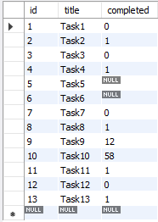
datatype – boolean
CREATE TABLE temp (col1 INT ,col2 BOOL, col3 BOOLEAN);
CREATE TABLE tasks ( id INT AUTO_INCREMENT PRIMARY KEY, title VARCHAR(255) NOT NULL, completed BOOLEAN);
INSERT INTO tasks VALUE(default, 'Task1', 0);
INSERT INTO tasks VALUE(default, 'Task2', 1);
INSERT INTO tasks VALUE(default, 'Task3', False);
INSERT INTO tasks VALUE(default, 'Task4', True);
INSERT INTO tasks VALUE(default, 'Task5', null);
INSERT INTO tasks VALUE(default, 'Task6', default);
INSERT INTO tasks VALUE(default, 'Task7’, 1 > 2);
INSERT INTO tasks VALUE(default, 'Task8’, 1 < 2);
INSERT INTO tasks VALUE(default, 'Task9', 12);
INSERT INTO tasks VALUE(default, 'Task10', 58);
INSERT INTO tasks VALUE(default, 'Task11', .75);
INSERT INTO tasks VALUE(default, 'Task12', .15);
INSERT INTO tasks VALUE(default, 'Task13', 'a' = 'a');
Note:
BOOL and BOOLEAN are synonym of TINYINT(1)

Slide 83
datatype – enum
An ENUM column can have a maximum of 65,535 distinct elements.
ENUM values are sorted based on their index numbers, which depend on the order in which the enumeration members were listed in the column specification.
Default value, NULL if the column can be NULL, first enumeration value if NOT NULL
CREATE TABLE temp (col1 INT, COL2 ENUM('A','B','C') NULL);
INSERT INTO temp(col1) VALUES (1);
CREATE TABLE temp (col1 INT, col2 ENUM('A','B','C') NOT NULL);
INSERT INTO temp(col1) VALUES (1);
CREATE TABLE temp (col1 INT, col2 ENUM('') NOT NULL);
INSERT INTO temp (col1, col2) VALUES (1,'THIS IS THE TEST');
membership ENUM('Silver', 'Gold', 'Diamond', 'Platinum')
interest ENUM('Movie', 'Music', 'Concert')
zone ENUM('North', 'South', 'East', 'West')
season ENUM('Winter', 'Summer', 'Monsoon', 'Autumn')
sortby ENUM('Popularity', 'Price -- Low to High', 'Price -- High to Low', 'Newest First')
status ENUM('active', 'inactive', 'pending', 'expired', 'Shipped', 'In Process', 'Resolved', 'On Hold', 'Cancelled', 'Disputed')
Note:
You cannot use user variable as an enumeration value. This pair of statements do not work:
SET @mysize = 'medium';
CREATE TABLE sizes ( size ENUM('small', @mysize, 'large')); // error

Slide 84
datatype – set
A SET column can have a maximum of 64 distinct members.
A SET is a string object that can have zero or more values, each of which must be chosen from a list of permitted values specified when the table is created.
SET column values that consist of multiple set members are specified with members separated by commas (,).
CREATE TABLE clients (
id INT AUTO_INCREMENT PRIMARY KEY,
name VARCHAR(5),
membership ENUM('Silver', 'Gold', 'Diamond'),
interest SET('Movie', 'Music', 'Concert'));
INSERT INTO clients (name, membership, interest) VALUES('Saleel', 'Gold', 'Music');
INSERT INTO clients (name, membership, interest) VALUES('Saleel', 'Premium', 'Movie, Concert');

Slide 85
Use a CREATE TABLE statement to specify the layout of your table.
CREATE TABLE `123` (c1 INT, c2 VARCHAR(10));
create table
Use a CREATE TABLE statement to specify the layout of your table.
Remember:
by default, tables are created in the default database, using the InnoDB storage engine.
error occurs if the table exists.
error occurs if there is no default database.
error occurs if the database does not exist.
Note:
Table names are stored in lowercase on disk. MySQL converts all table names to lowercase on storage. This behavior also applies to database names and table aliases.
e.g. show variables like 'lower_case_table_names';

Slide 86
create table
syntax
e.g.
CREATE TABLE student (
ID INT,
firstName VARCHAR(45),
lastName VARCHAR(45),
DoB DATE,
emailID VARCHAR(128)
);
CREATE [TEMPORARY] TABLE [IF NOT EXISTS] tbl_name
(create_defineation, . . .)
[table_options]
[partition_options]
create_definition:
col_name column_definition
column_definition:
data_type [NOT NULL | NULL] [DEFAULT default_value]
[AUTO_INCREMENT] [UNIQUE [KEY] | [PRIMARY] KEY]
[reference_definition]
| data_type [GENERATED ALWAYS] AS (expression) [VIRTUAL]
[VISIBLE | INVISIBLE]
table_options:
ENGINE [=] engine_name
show engines;
set default_storage_engine = memory;

Slide 87
default value
The DEFAULT specifies a default value for the column.

Slide 88

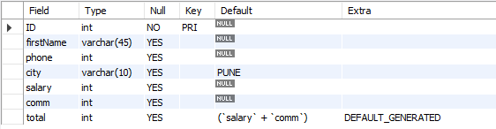
default value
col_name data_type DEFAULT value
The DEFAULT specifies a default value for the column.
CREATE TABLE posts (
postID INT,
postTitle VARCHAR(255),
postDate DATETIME DEFAULT NOW(),
deleted INT
);
# version 8.0 and above.
CREATE TABLE empl (
ID INT PRIMARY KEY,
firstName VARCHAR(45),
phone INT,
city VARCHAR(10) DEFAULT 'PUNE',
salary INT,
comm INT,
total INT DEFAULT(salary + comm)
);

Slide 89
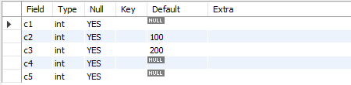
default value
The DEFAULT example.
CREATE TABLE temp (
c1 INT,
c2 INT DEFAULT 100,
c3 INT DEFAULT 200,
c4 INT,
c5 INT
);
INSERT INTO temp VALUES();
INSERT INTO temp VALUES(1, DEFAULT, DEFAULT, 1, 1);
INSERT INTO temp VALUES(2, DEFAULT(c2), DEFAULT(c3), 2, 2);
INSERT INTO temp VALUES(3, DEFAULT(c3), DEFAULT(c2), 3, 3);

Slide 90
Note:
Your database table has X columns, Where as the VALUES you are passing are for (X-1) or (X+1). This mismatch of column-values will giving you the error.
Inserting a string into a string column (CHAR, VARCHAR, TEXT, or BLOB) that exceeds the column maximum length. The value is truncated to the column maximum length.
insert rows
INSERT command inserts new rows into an existing table.
You can insert data using following methods:
INSERT ... VALUES
INSERT ... SET
INSERT ... SELECT

Slide 91
insert rows using values

Slide 92
dml- insert … values
INSERT inserts new rows into an existing table. The INSERT ... VALUES
INSERT [IGNORE] [INTO] tbl_name [PARTITION (partition_name [, partition_name] ...)] [ (col_name, . . .) ] { VALUES | VALU E } ( { expr | DEFAULT }, . . .), (. . .), . . . [ ON DUPLICATE KEY UPDATE assignment_list ]
The affected-rows value for an INSERT can be obtained using the ROW_COUNT() function.
Column Values
Column List
Inserting multiple rows

Slide 93
dml- insert … values
INSERT inserts new rows into an existing table. The INSERT ... VALUES
INSERT [IGNORE] [INTO] tbl_name [PARTITION (partition_name [, partition_name] ...)] [ (col_name, . . .) ] { VALUES | VALU E } ( { expr | DEFAULT }, . . .), (. . .), . . . [ ON DUPLICATE KEY UPDATE assignment_list ]
CREATE TABLE student (
ID INT PRIMARY KEY,
nameFirst VARCHAR(45),
nameLast VARCHAR(45),
DoB DATE ,
emailID VARCHAR(128)
);
e.g.
INSERT INTO student VALUES (29, 'sharmin', 'patil', '1999-11-10', 'sharmin.patil@gmail.com');
INSERT INTO student (ID, nameFirst, nameLast, DOB, emailID) VALUES (30, 'john', 'thomas', '1983-11-10', 'john.thomas@gmail.com' );
INSERT INTO student (ID, nameFirst, emailID) VALUES (31, 'jack', 'jack.thorn@gmail.com');
INSERT INTO student (ID, nameFirst) VALUES (32, 'james'), (33, 'jr. james'), (34, 'sr. james');

Slide 94
ORDER BY in UPDATE: if the table contains two values 1 and 2 in the id column and 1 is updated to 2 before 2 is updated to 3, an error occurs. To avoid this problem, add an ORDER BY clause to cause the rows with larger id values to be updated before those with smaller values.
Note:
Here c1 column is a Primary Key
UPDATE temp SET c1 = c1 - 1 ORDER BY c1 ASC; # In case of decrement
UPDATE temp SET c1 = c1 + 1 ORDER BY c1 DESC; # In case of increment
In a SET statement, = is treated identically to :=
single-table update
SET @x := 0;
UPDATE emp SET id = @x:= @x+1;
UPDATE t, (SELECT isactive, COUNT(isactive) r1 FROM emp GROUP BY isactive) a SET t.c2 = a.r1 WHERE t.c1 = a.isactive;
mysql> SELECT * FROM t;
+-------+--------+
| c1 | c2 |
+-------+--------+
| 0 | NULL |
| 1 | NULL |
+-------+--------+
+-------+------+
| c1 | c2 |
+-------+------+
| 0 | 6 |
| 1 | 14 |
+-------+------+
e.g.
Update top 2 rows.
Update UnitPrice for the top 5 most expensive products.

Slide 95
single-table update
The UPDATE statement updates columns of existing rows in the named table with new values. The SET clause indicates which columns to modify and the values they should be given. The WHERE clause, if given, specifies the conditions that identify which rows to update. With no WHERE clause, all rows are updated. If the ORDER BY clause is specified, the rows are updated in the order that is specified. The LIMIT clause places a limit on the number of rows that can be updated.
UPDATE tbl_name SET col_name1 = { expr1 | DEFAULT } [, col_name2 = { expr2 | DEFAULT } ] . . .
[WHERE where_condition]
[ORDER BY . . .]
[LIMIT row_count]
UPDATE temp SET dname = 'new_value' LIMIT 2;
UPDATE temp SET c1 = 'new_value' ORDER BY loc LIMIT 2;
UPDATE temp SET c1 := 'new_value' WHERE deptno < 50;
UPDATE temp SET c1 := 'new_value' WHERE deptno < 50 LIMIT 2;
ALTER TABLE dept ADD SUMSALARY INT;
UPDATE dept SET sumsalary = (SELECT SUM(sal) FROM emp WHERE emp.deptno = dept.deptno GROUP BY emp.deptno);
UPDATE candidate SET totalvotes = (SELECT COUNT(*) FROM votes WHERE candidate.id = votes.candidateID GROUP BY votes.candidateID);
UPDATE duplicate SET id = ( SELECT @cnt := @cnt + 1 );

Slide 96
single-table delete

Slide 97
single-table delete
The DELETE statement deletes rows from tbl_name and returns the number of deleted rows. To check the number of deleted rows, call the ROW_COUNT() function. The optional WHERE clause identify which rows to delete. With no WHERE clause, all rows are deleted. If the ORDER BY clause is specified, the rows are deleted in the order that is specified. The LIMIT clause places a limit on the number of rows that can be deleted.
DELETE FROM tbl_name
[PARTITION (partition_name [, partition_name] . . .)]
[WHERE where_condition]
[ORDER BY . . .]
[LIMIT row_count]
Note:
LIMIT clauses apply to single-table deletes, but not multi-table deletes.
DELETE FROM temp;
DELETE FROM temp ORDER BY loc LIMIT 2;
DELETE FROM temp WHERE deptno < 50;
DELETE FROM temp WHERE deptno < 50 LIMIT 2;

Slide 98
delete vs truncate
DELETE
VS
TRUNCATE
DELETE | TRUNCATE
You can specify the tuple that you want to delete. | It deletes all the tuples from a relation.
DELETE is a Data Manipulation Language command. | TRUNCATE is a Data Definition Language command.
DELETE command can have WHERE clause. | TRUNCATE command do not have WHERE clause.
DELETE command activates the trigger applied on the table and causes them to fire. | TRUNCATE command does not activate the triggers to fire.
DELETE command eliminate the tuples one-by-one. | TRUNCATE delete the entire data page containing the tuples.
DELETE command lock the row/tuple before deleteing it. | TRUNCATE command lock data page before deleting table data.
DELETE command acts slower as compared to TRUNCATE. | TRUNCATE is faster as compared to DELETE.
DELETE records transaction log for each deleted tuple. | TRUNCATE record transaction log for each deleted data page.
DELETE command can be followed either by COMMIT or ROLLBACK. | TRUNCATE command can't be ROLLBACK.

Slide 99
auto_increment column
The AUTO_INCREMENT attribute can be used to generate a unique number/identity for new rows.

Slide 100
auto_increment
IDENTITY is a synonym to the LAST_INSERT_ID variable.
col_name data_type AUTO_INCREMENT [UNIQUE [KEY] | [PRIMARY] KEY]
Remember:
There can be only one AUTO_INCREMENT column per table.
it must be indexed.
it cannot have a DEFAULT value.
it works properly only if it contains only positive values.
It applies only to integer and floating-point types.
when you insert a value of NULL or 0 into AUTO_INCREMENT column, it generates next value.
use LAST_INSERT_ID() function to find the row that contains the most recent AUTO_INCREMENT value.
SELECT @@IDENTITY
SELECT LAST_INSERT_ID()
SET INSERT_ID = 7
CREATE TABLE posts (
c1 INT UNIQUE KEY AUTO_INCREMENT,
c2 VARCHAR(20)
) AUTO_INCREMENT = 2; // auto_number will start with value 2.

Slide 101


auto_increment
The auto_increment specifies a auto_increment value for the column.
CREATE TABLE posts (
postID INT AUTO_INCREMENT UNIQUE KEY,
postTitle VARCHAR(255),
postDate DATETIME DEFAULT NOW(),
deleted INT
);
CREATE TABLE comments (
commentID INT AUTO_INCREMENT PRIMARY KEY,
comment TEXT,
commentDate DATETIME DEFAULT NOW(),
deleted INT
);

Slide 102
CREATE TABLE . . . LIKE . . ., the destination table preserves generated column information from the original table.
CREATE TABLE . . . SELECT . . ., the destination table does not preserves generated column information from the original table.
generated column
Remember:
Stored functions and user-defined functions are not permitted.
Stored procedure and function parameters are not permitted.
Variables (system variables, user-defined variables, and stored program local variables) are not permitted.
Subqueries are not permitted.
The AUTO_INCREMENT attribute cannot be used in a generated column definition.
Triggers cannot use NEW.COL_NAME or use OLD.COL_NAME to refer to generated columns.
Note:
The expression can contain literals, built-in functions with no parameters, operators, or references to any column within the same table. If you use a function, it must be scalar and deterministic.

Slide 103
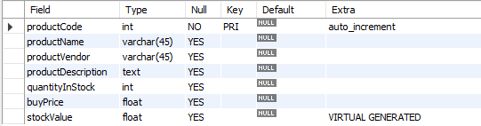
virtual column - generated always
col_name data_type [GENERATED ALWAYS] AS (expression) [VIRTUAL | STORED]
VIRTUAL: Column values are not stored, but are evaluated when rows are read, immediately after any BEFORE triggers. A virtual column takes no storage.
STORED: Column values are evaluated and stored when rows are inserted or updated. A stored column does require storage space and can be indexed.
Note:
The default is VIRTUAL if neither keyword is specified.
CREATE TABLE product(
productCode INT AUTO_INCREMENT PRIMARY KEY,
productName VARCHAR(45),
productVendor VARCHAR(45),
productDescription TEXT,
quantityInStock INT,
buyPrice FLOAT,
stockValue FLOAT GENERATED ALWAYS AS(quantityInStock * buyPrice) VIRTUAL
);

Slide 104
visible / invisible columns
Columns are visible by default. To explicitly specify visibility for a new column, use a VISIBLE or INVISIBLE keyword as part of the column definition for CREATE TABLE or ALTER TABLE.
Note:
An invisible column is normally hidden to queries, but can be accessed if explicitly referenced. Prior to MySQL 8.0.23, all columns are visible.
A table must have at least one visible column. Attempting to make all columns invisible produces an error.
SELECT * does not include invisible columns.

Slide 105
invisible column
col_name data_type INVISIBLE
CREATE TABLE employee (
ID INT AUTO_INCREMENT PRIMARY KEY,
firstName VARCHAR(40),
salary INT,
commission INT,
total INT DEFAULT(salary + commission) INVISIBLE
) ;
CREATE TABLE employee (
ID INT PRIMARY KEY AUTO_INCREMENT INVISIBLE ,
firstName VARCHAR(40)
) ;
ALTER TABLE employee MODIFY total INT VISIBLE;
ALTER TABLE employee MODIFY total INT INVISIBLE;
INSERT INTO employee (firstName, salary, commission) VALUES('ram', 4700, -700);
INSERT INTO employee (firstName, salary, commission) VALUES('pankaj', 3400, NULL);
INSERT INTO employee (firstName, salary, commission) VALUES('rajan', 3200, 250);
INSERT INTO employee (firstName, salary, commission) VALUES('ninad', 2600, 0);
INSERT INTO employee (firstName, salary, commission) VALUES('omkar', 4500, 300);
SELECT * FROM employee;

Slide 106
varbinary column
TODO
Note:
TODO
TODO
TODO

Slide 107
varbinary column
col_name VARBINARY
CREATE TABLE login (
ID INT AUTO_INCREMENT PRIMARY KEY,
userName VARCHAR(40),
password VARBINARY(40)
) ;
INSERT INTO login(userName, password) VALUES('ram', 'ram@123');
INSERT INTO login(userName, password) VALUES('pankaj', 'pankaj');
INSERT INTO login(userName, password) VALUES('rajan', 'rajan');
INSERT INTO login(userName, password) VALUES('ninad', 'ninad');
INSERT INTO login(userName, password) VALUES('omkar', 'omkar');
SELECT * FROM login;
SELECT username, CAST(password as char) FROM login;

Slide 108
alter table
ALTER TABLE changes the structure of a table.
Note:
you can add or delete columns,
create or destroy indexes,
change the type and size of existing columns, or
rename columns or the table itself.

Slide 109
alter table
syntax
ALTER TABLE tbl_name
[alter_specification [, alter_specification] . . .
| ADD [COLUMN] col_name column_definition [FIRST | AFTER col_name ]
| ADD [COLUMN] (col_name column_definition, . . .)
| ADD {INDEX|KEY} [index_name] (index_col_name, . . .)
| ADD [CONSTRAINT [ symbol ]] PRIMARY KEY
| ADD [CONSTRAINT [symbol]] UNIQUE KEY
| ADD [CONSTRAINT [symbol]] FOREIGN KEY reference_definition
| CHANGE [COLUMN] old_col_name new_col_name column_definition [FIRST|AFTER col_name]
| MODIFY [COLUMN] col_name column_definition [FIRST | AFTER col_name]
| DROP [COLUMN] col_name
| DROP PRIMARY KEY
| DROP {INDEX|KEY} index_name
| DROP FOREIGN KEY fk_symbol
| RENAME [TO|AS] new_tbl_name
| ALTER [COLUMN] col_name { SET DEFAULT {literal | (expr)} | SET {VISIBLE | INVISIBLE} | DROP DEFAULT }

Slide 110
alter table
Remember:
Change Columns :- You can rename a column using a CHANGE old_column_name new_column_name column_definition clause. To do so, specify the CHANGE old_column_name and new_column_name column names and the definition that the column currently has.
Modify Columns :- You can also use MODIFY to change a column's type and size without renaming it.
Dropping Columns :- If a table contains only one column, the column cannot be dropped. If columns are dropped from a table, the columns are also removed from any index of which they are a part. If all columns that make up an index are dropped, the index is dropped as well.
Note:
To convert a table from one storage engine to another, use an ALTER TABLE statement that indicates the new engine:
ALTER TABLE tbl_name ENGINE = InnoDB;
ALTER TABLE tbl_name ADD col1 INT, ADD col2 INT;
ALTER TABLE tbl_name DROP COLUMN col1, DROP COLUMN col2 , ADD col3 INT;

Slide 111
add column
ALTER TABLE tbl_name [alter_specification [, alter_specification] . . .]
alter_specification
ADD [COLUMN] col_name column_definition [FIRST | AFTER col_name ]
ADD [COLUMN] (col_name column_definition, . . .)

Slide 112

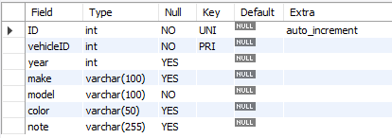
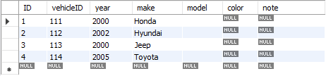
add column
CREATE TABLE vehicles (
vehicleID INT PRIMARY KEY ,
year INT,
make VARCHAR(100)
);
ALTER TABLE vehicles
ADD ID INT UNIQUE auto_increment first,
ADD model VARCHAR(100) not null,
ADD color VARCHAR(50),
ADD note VARCHAR(255);
INSERT INTO vehicles VALUES (111, 2000, 'Honda');
INSERT INTO vehicles VALUES (112, 2002, 'Hyundai');
INSERT INTO vehicles VALUES (113, 2000, 'Jeep');
INSERT INTO vehicles VALUES (114, 2005, 'Toyota');

Slide 113
modify column
ALTER TABLE tbl_name [alter_specification [, alter_specification] ...]
alter_specification
MODIFY [COLUMN] col_name column_definition [FIRST | AFTER col_name]

Slide 114
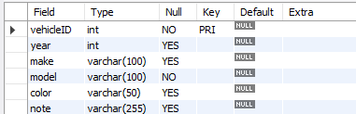
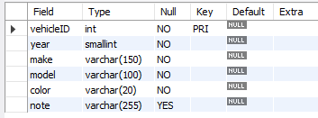
modify column
CREATE TABLE vehicles (
vehicleID INT PRIMARY KEY ,
year INT,
make VARCHAR(100),
model VARCHAR(100) not null,
color VARCHAR(50),
note VARCHAR(255)
);
ALTER TABLE vehicles
MODIFY year SMALLINT not null,
MODIFY make VARCHAR(150) not null,
MODIFY color VARCHAR(20) not null;
INSERT INTO vehicles VALUES (111, 2000, 'Honda', 'A1', 'silver', ' Honda was the first Japanese automobile manufacturer to release a dedicated luxury brand, Acura, in 1986.');
INSERT INTO vehicles VALUES (112, 2002, 'Hyundai', 'AC1', 'white', ' Hyundai operates the world's largest integrated automobile manufacturing facility in Ulsan, South Korea which has an annual production capacity of 1.6 million units.');
INSERT INTO vehicles VALUES (113, 2000, 'Jeep', 'D2', 'black', ' Fiat Chrysler Automobiles has owned Jeep since 2014. Previous owners include the Kaiser Jeep Corporation and American Motors Corporation. Most Jeeps are American-made, except for a select few models. The Toledo Assembly Complex in Ohio manufactures the Jeep Wrangler.');

Slide 115
change column
ALTER TABLE tbl_name [alter_specification [, alter_specification] ...]
alter_specification
CHANGE [COLUMN] old_col_name new_col_name column_definition [ FIRST | AFTER col_name ]

Slide 116
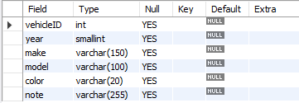
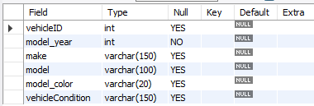
change column
CREATE TABLE vehicles (
vehicleID INT,
year SMALLINT,
make VARCHAR(150),
model VARCHAR(100),
color VARCHAR(20),
note VARCHAR(255)
);
ALTER TABLE vehicles
CHANGE year model_year INT,
CHANGE color model_color VARCHAR(20),
CHANGE note vehicleCondition VARCHAR(150);

Slide 117
change column
CREATE TABLE users (
ID INT PRIMARY KEY,
userName VARCHAR(40),
password VARCHAR(25),
email VARCHAR(255)
) ;
CREATE TABLE login (
ID INT PRIMARY KEY,
userID INT,
loginDate DATE,
loginTime TIME,
constraint fk_userID FOREIGN KEY(userID) REFERENCES users(ID)
) ;
INSERT INTO users VALUES (1, 'rajan', 'ranaj123', 'rajan447.gmail.com');
INSERT INTO users VALUES (2, 'raj', 'raj', 'raj.gmail.com');
INSERT INTO login VALUES (1, 1, curdate(), curtime());
INSERT INTO login VALUES (2, 1, curdate(), curtime());
INSERT INTO login VALUES (3, 2, curdate(), curtime());
INSERT INTO login VALUES (4, NULL, curdate(), curtime());
ALTER TABLE users CHANGE ID userID INT;
ALTER TABLE login CHANGE userID UID INT;
INSERT INTO login VALUES (5, NULL, curdate(), curtime());

Slide 118
drop column
ALTER TABLE tbl_name [alter_specification [, alter_specification] ...]
alter_specification
DROP [COLUMN] col_name

Slide 119
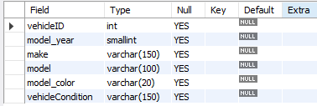

drop column
CREATE TABLE vehicles (
vehicleID INT,
model_year SMALLINT,
make VARCHAR(150),
model VARCHAR(100),
model_color VARCHAR(20),
vehicleCondition VARCHAR(150)
);
ALTER TABLE vehicles
CHANGE model_year year INT not null,
DROP model,
DROP model_color,
DROP vehicleCondition;

Slide 120
alter table
Sample table
Rename columns
CREATE TABLE vehicles (
vehicleID INT PRIMARY KEY ,
year INT,
make VARCHAR(100)
);
ALTER TABLE vehicles
CHANGE year model_year SMALLINT NOT NULL,
CHANGE color model_color VARCHAR(20),
CHANGE note vehicleCondition VARCHAR(150);
Add new columns to a table
DROP columns
ALTER TABLE vehicles
ADD model VARCHAR(100) NOT NULL,
ADD color VARCHAR(50),
ADD note VARCHAR(255);
ALTER TABLE vehicles
CHANGE model_year year INT NOT NULL,
DROP model,
DROP model_color,
DROP vehicleCondition;
Modify columns
ALTER TABLE vehicles
MODIFY year SMALLINT NOT NULL,
MODIFY color VARCHAR(20) NOT NULL,
MODIFY make VARCHAR(150) NOT NULL;

Slide 121
drop table
Remember:
DROP and TRUNCATE are DDL commands, whereas DELETE is a DML command.
DELETE operations can be rolled back (undone), while DROP and TRUNCATE operations cannot be rolled back (Auto COMMIT).
Dropping a TABLE also drops any TRIGGERS for the table.
Dropping a TABLE also drops any INDEX for the table.
Dropping a TABLE will not drops any VIEW for the table.
If you try to drop a PARENT/MASTER TABLE, it will not get dropped.

Slide 122
drop table
DROP [TEMPORARY] TABLE [IF EXISTS] tbl_name [, tbl_name] ...
Note:
All table data and the table definition are removed.
DROP login;
DROP TABLE users;
DROP TABLE login, users;

Slide 123
constraints
CONSTRAINT is used to define rules to allow or restrict what values can be stored in columns. The purpose of inducing constraints is to enforce the integrity of a database.
CONSTRAINTS can be classified into two types –
Column Level
Table Level
The column level constraints can apply only to one column where as table level constraints are applied to the entire table.

Slide 124
Remember:
PRI => primary key
UNI => unique key
MUL=> is basically an index that is neither a primary key nor a unique key. The name comes from
"multiple" because multiple occurrences of the same value are allowed.
constraints
To limit or to restrict or to check or to control.
Note:
a table with a foreign key that references another table's primary key is MUL.
If more than one of the Key values applies to a given column of a table, Key displays the one with the highest priority, in the order PRI, UNI, and MUL.

Slide 125
Keys are used to establish relationships between tables and also to uniquely identify any record in the table.
types of Keys?
r = Employee(EmployeeID, FullName, job, salary, PAN, DateOfBirth, emailID, deptno)
Candidate Key: are individual columns in a table that qualifies for uniqueness of all the rows. Here in Employee table EmployeeID, PAN or emailID are Candidate keys.
Primary Key: is the columns you choose to maintain uniqueness in a table. Here in Employee table you can choose either EmployeeID, PAN or emailID columns, EmployeeID is preferable choice.
Alternate Key: Candidate column other the primary key column, like if EmployeeID is primary key then , PAN or emailID columns would be the Alternate key.
Super Key: If you add any other column to a primary key then it become a super key, like EmployeeID + FullName is a Super Key.
Composite Key: If a table do not have any single column that qualifies for a Candidate key, then you have to select 2 or more columns to make a row unique. Like if there is no EmployeeID, PAN or emailID columns, then you can make FullName + DateOfBirth as Composite key. But still there can be a narrow chance of duplicate row.

Slide 126
Remember:
A primary key cannot be NULL.
A primary key value must be unique.
A table has only one primary key.
The primary key values cannot be changed, if it is referred by some other column.
The primary key must be given a value when a new record is inserted.
PRIMARY KEY constraint
Choosing a primary key is one of the most important steps in good database design. A primary key is a column that serves a special purpose. A primary key is a special column (or set of combined columns) in a relational database table, that is used to uniquely identify each record. Each database table needs a primary key.
Note:
Primary key in a relation is always associated with an INDEX object.
If, we give on a column a combination of NOT NULL & UNIQUE key then it behaves like a PRIMARY key.
If, we give on a column a combination of UNIQUE key & AUTO_INCREMENT then also it behaves like a PRIMARY key.

Slide 127
clustered and non-clustered index
Indexing in MySQL is a process that helps us to return the requested data from the table very fast. If the table does not have an index, it scans the whole table for the requested data.
MySQL allows two different types of Indexing:
Clustered Index
Non-Clustered Index
Clustered Index:- The InnoDB table uses a clustered index for optimizing the speed of most common lookups and DML operations like INSERT, UPDATE, and DELETE command. Clustered indexes sort and store the data rows in the table or view based on their key values that can be sorted in only one way. If the table column contains a primary key or unique key, MySQL creates a clustered index named PRIMARY based on that specific column.
Non-Clustered Index:- The indexes other than PRIMARY indexes (clustered indexes) called a non-clustered index. The non-clustered indexes are also known as secondary indexes. The non-clustered index and table data are both stored in different places. It is not sorted (ordering) the table data.

Slide 128
constraints – add primary key
col_name data_type PRIMARY KEY
The following example creates tables with PRIMARY KEY column.
CREATE TABLE users (
ID INT PRIMARY KEY,
userName VARCHAR(25),
password VARCHAR(25),
email VARCHAR(255)
) ;
CREATE TABLE purchase_orders (
po_number INT,
vendor_id INT NOT NULL,
po_status INT NOT NULL,
PRIMARY KEY(po_number)
);
CREATE TABLE supplier (
supplier_id INT,
supplier_name VARCHAR(50),
contact_name VARCHAR(50),
constraint pk_supplier_id PRIMARY KEY(supplier_id)
);
CREATE TABLE person (
ID INT NOT NULL UNIQUE,
lastName VARCHAR(45),
firstName VARCHAR(45),
age INT,
email VARCHAR(255)
);

Slide 129
constraints – add composite primary key
The following example creates tables with PRIMARY KEY column.
CREATE TABLE salesDetails (
customerID INT,
productID INT,
timeID INT,
qty INT,
salesDate DATE,
salesAmount INT,
PRIMARY KEY(customerID , productID, timeID)
) ;
customerID | productID | timeID | quantity | salesDate | salesAmount
Cust-001 | PRD-1 | D1-T1 | 100 | ●●●●●● | 25,00,000
Cust-001 | PRD-1 | D2-T1 | 100 | ●●●●●● | 25,00,000
Cust-001 | PRD-2 | D1-T1 | 200 | ●●●●●● | 50,00,000
Cust-002 | PRD-1 | D1-T1 | 100 | ●●●●●● | 25,00,000
Cust-004 | PRD-1 | D1-T1 | 100 | ●●●●●● | 25,00,000
Cust-004 | PRD-2 | D3-T1 | 200 | ●●●●●● | 50,00,000

Slide 130
constraints – add composite primary key
The following example creates tables with COMPOSITE PRIMARY KEY column.
CREATE TABLE payments (
paymentID INT,
orderID INT,
amount INT,
bankDetails VARCHAR(255),
PRIMARY KEY(paymentID , orderID)
) ;
CREATE TABLE order_product (
orderID INT,
productID INT,
qty INT,
rate INT,
constraint pk_orderID_productID PRIMARY KEY(orderID, productID)
) ;

Slide 131
ALTER TABLE table_name
ADD [ CONSTRAINT constraint_name ]
PRIMARY KEY (column1, column2, . . . column_n)
Add Primary Key using Alter

Slide 132
constraints – add primary key using alter
You can use the ALTER TABLE statement to ADD PRIMARY KEY on existing column.
ALTER TABLE table_name
ADD [ CONSTRAINT constraint_name ]
PRIMARY KEY (column1, column2, . . . column_n)
CREATE TABLE vendors (
vendor_id INT,
vendor_name VARCHAR(25),
address VARCHAR(255)
);
ALTER TABLE vendors ADD PRIMARY KEY(vendor_id);
ALTER TABLE vendors ADD constraint pk_vendor_id PRIMARY KEY(vendor_id);

Slide 133
ALTER TABLE table_name
DROP PRIMARY KEY
Drop Primary Key

Slide 134
constraints – drop primary key
You can use the ALTER TABLE statement to DROP PRIMARY KEY.
ALTER TABLE table_name
DROP PRIMARY KEY
CREATE TABLE vendors (
vendor_id INT,
vendor_name VARCHAR(25),
address VARCHAR(255)
);
ALTER TABLE vendors DROP PRIMARY KEY;

Slide 135
Remember:
A unique key can be NULL.
A unique key value must be unique.
A table can have multiple unique key.
A column can have unique key as well as a primary key.
UNIQUE KEY constraint
A UNIQUE key constraint is a set of one or more than one fields/columns of a table that uniquely identify a record in a database table.
Note:
Unique key in a relation is always associated with an INDEX object.

Slide 136
constraints – add unique key
col_name data_type UNIQUE KEY
The following example creates table with UNIQUE KEY column.
CREATE TABLE clients (
client_id INT,
first_name VARCHAR(50),
last_name VARCHAR(50),
company_name VARCHAR(255),
email VARCHAR(255) UNIQUE
);
CREATE TABLE contacts (
ID INT,
first_name VARCHAR(50),
last_name VARCHAR(50),
phone VARCHAR(15),
UNIQUE(phone)
);
CREATE TABLE brands (
ID INT,
brandName VARCHAR(30),
constraint uni_brandName UNIQUE(brandName)
);
SHOW INDEX FROM clients;

Slide 137
ALTER TABLE table_name
ADD [ CONSTRAINT constraint_name ]
UNIQUE (column1, column2, . . . column_n)
Add Unique Key using Alter

Slide 138
constraints – add unique key using alter
You can use the ALTER TABLE statement to ADD UNIQUE KEY on existing column.
ALTER TABLE table_name
ADD [ CONSTRAINT constraint_name ]
UNIQUE (column1, column2, . . . column_n)
CREATE TABLE shop (
ID INT,
shop_name VARCHAR(30)
);
ALTER TABLE shop ADD UNIQUE(shop_name);
ALTER TABLE shop ADD constraint uni_shop_name UNIQUE(shop_name);

Slide 139
ALTER TABLE table_name
DROP INDEX constraint_name;
Drop Unique Key

Slide 140
constraints – drop unique key
You can use the ALTER TABLE statement to DROP UNIQUE KEY.
ALTER TABLE table_name
ADD [ CONSTRAINT constraint_name ]
UNIQUE (column1, column2, . . . column_n)
ALTER TABLE users DROP INDEX <COLUMN_NAME>;
ALTER TABLE users DROP INDEX U_USER_ID; #CONSTRAINT NAME
CREATE TABLE users (
ID INT PRIMARY KEY,
userName VARCHAR(40),
password VARCHAR(255),
email VARCHAR(255) UNIQUE KEY
) ;
CREATE TABLE users (
ID INT PRIMARY KEY,
userName VARCHAR(40),
password VARCHAR(255),
email VARCHAR(255),
constraint uni_email UNIQUE KEY(email)
) ;
ALTER TABLE users DROP INDEX email;
ALTER TABLE users DROP INDEX uni_email;

Slide 141
FOREIGN KEY constraint
A FOREIGN KEY is a key used to link two tables together. A FOREIGN KEY is a field (or collection of fields) in one table that refers to the PRIMARY KEY in another table. The table containing the foreign key is called the child table, and the table containing the candidate key is called the referenced or parent table.

Slide 142
constraints – foreign key
Remember:
A foreign key can have a different column name from its primary key.
DataType of primary key and foreign key column must be same.
It ensures rows in one table have corresponding rows in another.
Unlike the Primary key, they do not have to be unique.
Foreign keys can be null even though primary keys can not.
Note:
The table containing the FOREIGN KEY is referred to as the child table, and the table containing the PRIMARY KEY (referenced key) is the parent table.
PARENT and CHILD tables must use the same storage engine,
and they cannot be defined as temporary tables.

Slide 143
insert, update, & delete – (primary key/foreign key)
A referential constraint could be violated in following cases.
An INSERT attempt to add a row to a child table that has a value in its foreign key columns that does not match a value in the corresponding parent table's column.
An UPDATE attempt to change the value in a child table's foreign key columns to a value that has no matching value in the corresponding parent table's parent key.
An UPDATE attempt to change the value in a parent table's parent key to a value that does not have a matching value in a child table's foreign key columns.
A DELETE attempt to remove a record from a parent table that has a matching value in a child table's foreign key columns.
Note:
PARENT and CHILD tables must use the same storage engine,
and they cannot be defined as temporary tables.
If we don’t give constraint name. System will automatically generated the constraint name and will assign to foreign key constraint. e.g. login_ibfk_1, login_ibfk_2, …..

Slide 144
anomaly – (primary key/foreign key)
Remember:
Student (parent) Table
student_course (child) Table
RollNo | Name | Mobile | City | State | isActive
1 | Ramesh | ●●●● | Pune | MH | 1
2 | Amit | ●●●● | Baroda | GJ | 1
3 | Rajan | ●●●● | Surat | GJ | 1
4 | Bhavin | ●●●● | Baroda | GJ | 1
5 | Pankaj | ●●●● | Surat | GJ | 1
RollNo | CourceDuration | CourceName
1 | 1.5 month | RDBMS
2 | 1.2 month | NoSQL
3 | 2 month | Networking
1 | 2 month | Java
2 | 2 month | .NET
Insertion anomaly:
If we try to insert a record in Student_Course (child) table with RollNo = 7, it will not allow.
Updation and Deletion anomaly:
If you try to chance the RollNo from Student (parent) table with RollNo = 6 whose RollNo = 1 , it will not allow.
If you try to chance the RollNo from Student_Course (child) table with RollNo = 9 whose RollNo = 3 , it will not allow.
If we try to delete a record from Student (parent) table with RollNo = 1, it will not allow.

Slide 145
alter, drop – (primary key/foreign key)
Remember:
Parent Table
student = {
rollno INT, * (PK)
name VARCHAR(10),
mobile VARCHAR(10),
city VARCHAR(10),
state VARCHAR(10),
isActive BOOL
}
Child Table
student_course = {
rollno INT, * (FK)
courceduration VARCHAR(10),
courcename VARCHAR(10)
}
DDL command could be violated in following cases.
Alter command:
If we try to modify datatype of RollNo in Student or Student_Course table with VARCHAR, it will not allow.
If we try to apply auto_increment to RollNo in Student table, it will not allow
If we try to drop RollNo column from Student table , it will not allow.
Drop command:
If we try to drop Student (parent) table, it will not allow.

Slide 146
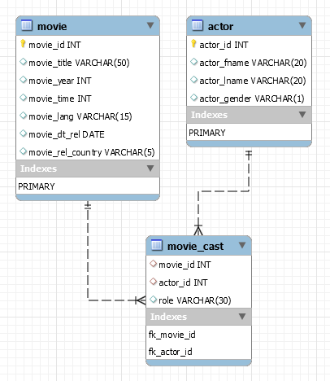
constraints – foreign key
A foreign key is a field in a table that matches another field of another table. A foreign key places constraints on data in the related tables, which enables MySQL to maintain referential integrity.
CREATE TABLE movie (
movie_id INT PRIMARY KEY,
movie_title VARCHAR(50),
movie_year INT,
movie_time INT,
movie_lang VARCHAR(15),
movie_dt_rel DATE,
movie_rel_country VARCHAR(5)
);
CREATE TABLE actor (
actor_id INT PRIMARY KEY,
actor_fname VARCHAR(20),
actor_lname VARCHAR(20),
actor_gender VARCHAR(1)
);
CREATE TABLE movie_cast (
movie_id INT,
actor_id INT,
role VARCHAR(30),
constraint fk_movie_id FOREIGN KEY(movie_id) REFERENCES movie(movie_id),
constraint fk_actor_id FOREIGN KEY(actor_id) REFERENCES actor(actor_id)
);

Slide 147
QUESTION – find foreign key columns
The following example find Foreign Key columns.
CREATE TABLE owner (
owner_id INT PRIMARY KEY,
first_name VARCHAR(50),
last_name VARCHAR(50),
email VARCHAR(255)
);
CREATE TABLE contacts (
contact_id INT PRIMARY KEY,
owner_id INT,
contact_number VARCHAR(15)
);
CREATE TABLE shop (
shop_id INT,
owner_id INT,
shop_name VARCHAR(30)
);
CREATE TABLE shop_brand (
ID INT PRIMARY KEY,
shop_id INT,
brand_id INT
);
CREATE TABLE brands (
brand_id INT PRIMARY KEY,
brand_name VARCHAR(30) UNIQUE
);

Slide 148
ALTER TABLE table_name
ADD [ CONSTRAINT constraint_name ]
FOREIGN KEY (child_col1, child_col2, . . . child_col_n)
REFERENCES parent_table (parent_col1, parent_col2, . . . parent_col_n);
Add Foreign Key Constraint using Alter

Slide 149
constraints – add foreign key using alter
You can use the ALTER TABLE statement to ADD FOREIGN KEY on existing column.
ALTER TABLE table_name
ADD [ CONSTRAINT constraint_name ]
FOREIGN KEY (child_col1, child_col2, . . . child_col_n)
REFERENCES parent_table (parent_col1, parent_col2, . . . parent_col_n);
CREATE TABLE users (
ID INT PRIMARY KEY,
userName VARCHAR(40),
password VARCHAR(255),
email VARCHAR(255) UNIQUE KEY
) ;
CREATE TABLE login (
ID INT PRIMARY KEY,
userID INT,
loginDate DATE,
loginTime TIME
) ;
ALTER TABLE login ADD FOREIGN KEY(userID) REFERENCES users(ID);
ALTER TABLE login ADD constraint fk_userID FOREIGN KEY(userID) REFERENCES users(ID);

Slide 150
ALTER TABLE table_name
DROP FOREIGN KEY constraint_name
Drop Foreign Key Constraint using Alter

Slide 151
constraints – drop foreign key
You can use the ALTER TABLE statement to DROP FOREIGN KEY.
CREATE TABLE users (
ID INT PRIMARY KEY ,
userName VARCHAR(40),
password VARCHAR(255),
email VARCHAR(255)
) ;
CREATE TABLE login (
ID INT PRIMARY KEY,
userID INT,
loginDate DATE,
loginTime TIME,
FOREIGN KEY(userID) REFERENCES users(ID)
) ;
CREATE TABLE login (
ID INT PRIMARY KEY,
userID INT,
loginDate DATE,
loginTime TIME,
constraint fk_userID FOREIGN KEY(userID) REFERENCES users(ID)
) ;
ALTER TABLE login DROP FOREIGN KEY fk_userID;
ALTER TABLE login DROP FOREIGN KEY login_ibfk_1; // login_ibfk_1 is the default constraint name.
SELECT TABLE_NAME, CONSTRAINT_NAME, CONSTRAINT_TYPE FROM information_schema.table_constraints WHERE TABLE_SCHEMA='DB2’;

Slide 152






CREATE TABLE TEST (c1 INT, c2 INT, c3 INT, check (c3 = SUM(c1)));
// ERROR
Check Constraint

Slide 153
constraints – check
CHECK condition expressions must follow some rules.
Literals, deterministic built-in functions, and operators are permitted.
Non-generated and generated columns are permitted, except columns with the AUTO_INCREMENT attribute.
Sub-queries are not permitted.
Environmental variables (such as CURRENT_USER, CURRENT_DATE, …) are not permitted.
Non-Deterministic built-in functions (such as AVG, COUNT, RAND, LAST_INSERT_ID, FIRST_VALUE, LAST_VALUE, ...) are not permitted.
Variables (system variables, user-defined variables, and stored program local variables) are not permitted.
Stored functions and user-defined functions are not permitted.
Note:
Prior to MySQL 8.0.16, CREATE TABLE permits only the following limited version of table CHECK constraint syntax, which is parsed and ignored.
Remember:
If you omit the constraint name, MySQL automatically generates a name with the following convention:
table_name_chk_n

Slide 154
constraints – check
col_name data_type CHECK(expr)
The following example creates USERS table with CHECK column.
CREATE TABLE users (
ID INT PRIMARY KEY,
userName VARCHAR(40),
password VARCHAR(255),
email VARCHAR(255),
ratings INT CHECK(ratings > 50)
) ;
CREATE TABLE users (
ID INT PRIMARY KEY,
userName VARCHAR(40),
password VARCHAR(255),
email VARCHAR(255),
ratings INT,
CHECK(ratings > 50)
) ;
CREATE TABLE users (
ID INT PRIMARY KEY,
userName VARCHAR(40),
password VARCHAR(255),
email VARCHAR(255),
ratings INT,
constraint chk_ratings CHECK(ratings > 50)
) ;
CREATE TABLE users (
ID INT PRIMARY KEY,
userName VARCHAR(40),
password VARCHAR(255),
email VARCHAR(255),
ratings INT,
constraint chk_ratings CHECK(ratings > 50),
constraint chk_email CHECK(LENGTH(email) > 12)
) ;

Slide 155
constraints – check
col_name data_type CHECK(expr)
The following example creates USERS table with CHECK column.
CREATE TABLE users (
ID INT PRIMARY KEY,
startDate DATE,
endDate DATE,
constraint chk_endDate CHECK(endDate > startDate + INTERVAL 7 day)
) ;
select * from check_constraints where CONSTRAINT_SCHEMA = 'z';

Slide 156
ALTER TABLE table_name
ADD [ CONSTRAINT constraint_name ]
CHECK (conidiation)
Add Check Constraint using Alter

Slide 157
constraints – add check using alter
You can use the ALTER TABLE statement to ADD CHECK KEY on existing column.
ALTER TABLE table_name
ADD CONSTRAINT [ constraint_name ]
CHECK (conidiation)
CREATE TABLE users (
ID INT PRIMARY KEY,
userName VARCHAR(40),
password VARCHAR(255),
email VARCHAR(255),
ratings INT
) ;
ALTER TABLE users ADD CHECK(ratings > 50);
ALTER TABLE users ADD constraint chk_ratings CHECK(ratings > 50);

Slide 158
ALTER TABLE table_name
DROP CHECK [ CONSTRAINT ] constraint_name
drop check constraint

Slide 159
constraints – drop check key
You can use the ALTER TABLE statement to DROP CHECK KEY.
CREATE TABLE users (
ID INT PRIMARY KEY,
userName VARCHAR(40),
password VARCHAR(255),
email VARCHAR(255),
ratings INT,
constraint chk_ratings CHECK(ratings > 50)
) ;
ALTER TABLE table_name
DROP CHECK [ CONSTRAINT ] constraint_name
ALTER TABLE users DROP CHECK chk_ratings;
ALTER TABLE users DROP constraint chk_ratings;
ALTER TABLE users DROP CHECK users_chk_1;
CREATE TABLE users (
ID INT PRIMARY KEY,
userName VARCHAR(40),
password VARCHAR(255),
email VARCHAR(255),
ratings INT,
CHECK(ratings > 50)
) ;
SELECT TABLE_NAME, CONSTRAINT_NAME, CONSTRAINT_TYPE FROM information_schema.table_constraints WHERE TABLE_SCHEMA='DB2' AND (TABLE_NAME LIKE 'U%' OR TABLE_NAME LIKE 'L%');

Slide 160

"Live as if you were to die tomorrow.
Learn as if you were to live forever"

